Slide 1
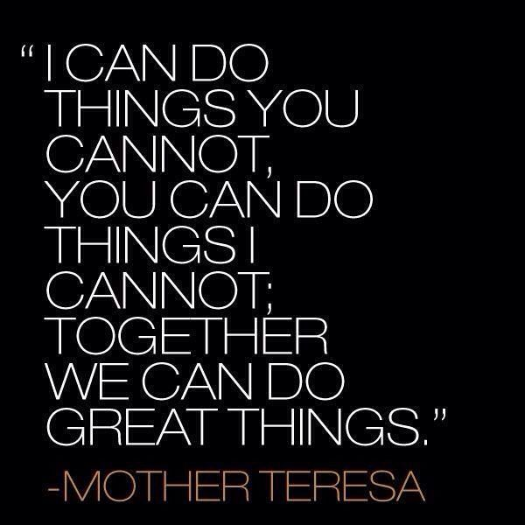
SOAR Expectations
Office Procedures

Slide 2
SOAR Connection Knowing which office staff can help you is: CHOICE! Verify this claim with a neighbor.
SAFE
ORGANIZED
ACCOUNTABLE
RESPECTFUL

Slide 3
Office Procedures
SOAR Positive Behaviors for All Office Areas:
Check in & check out at the front desk.
Be respectful and polite to office staff.
Be patient and wait in line for your turn.
Cell phone/technology use is allowed only between classes, before or after school, and with the permission of the office staff.

Slide 4
Office Procedures
SOAR Positive Attendance Office Behaviors
Ms. Brott and Ms. MettlerKnepper
Follow prearranged absence request procedures.
Clear-up unexcused absences within 48 hours.
Turn in signed parent notes for absences, appointments, etc.
Handle all student parking matters outside of class time with Ms. Minch.
Questions regarding student club accounts can be addressed by Ms. Wood.
To make an appointment with an administrator, please see Ms. Hayden.

Slide 5
Office Procedures
SOAR Positive Student Services Office Behaviors:
Ms. Roffers
Make an appointment with your school counselor at the front desk of student services.
Be at your scheduled student services appointments on time.
Drop-ins are appropriate only in emergency situations.
Handle work permit matters outside of class time (have all needed items with you).
Questions related to athletics can be addressed by Mr. Redwine in Student Services.

Slide 6
Office Procedures
SOAR Positive Office Behaviors
Please see the registrar for locker information, immunization records, student records, report cards, transcripts, and diplomas.
Ms. Rzepiejewski (the window between Attendance and Student Services)

Slide 7
SOAR Tip of the Day
Be Consistently Great
Be great every day. Be great in the classroom, the school and the community. Wherever we go and whatever we do, we will strive to be consistently great. Not just sometimes, not just when we feel like it. If you can do it great once, then you should be able to do it great every time. Great doesn’t mean you understand everything right away or that you are perfect. Great means you put forth full effort to achieve full potential.
SOAR Goals for the day (and every day ☺):
Fully engage in a complete class period.
Ask a question in class that will further your learning.

