Slide 1
Dear Parents,
Do as many of the activities as you would like with your child, following the directions on each page.
Many of the songs are already familiar, but if they aren’t, there is a link on each page that will play you the song. Have fun!
All the best,
Mrs. Swartz

Slide 2
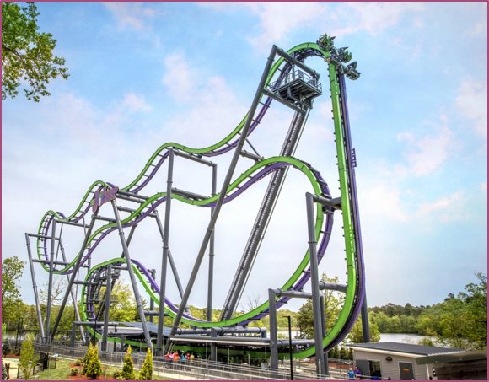
Follow the roller coaster with your voice. Try to do it different way – fast, slow, silly voice, monster voice.

Slide 3
Echo Singing – do the actions in each verse
Click on speaker and then play to hear recordings
Oh, my aunt came back,
from Guadeloupe,
She brought with her,
A hula hoop,
Oh, my aunt came back
From the county fair,
She brought with her,
A rocking chair.
Oh, my aunt came back,
From the city zoo,
She brought with her,
A nut like you! ☺
Oh my aunt came back,
From Timbuktu,
She brought with her,
A wooden show.
Oh, my aunt came back,
From old Japan,
She brought with her,
A waving fan.
Oh, my aunt came back,
From old Algiers,
She brought with her,
A pair of shears.

Slide 4
Silly Songs with actions.
Make actions to each verse.
Click on speaker and then play to hear recordings
My hat it has three corners,
Three corners has my hat
And had it not three corners
It would not be my hat!
Directions:
Sing whole song until you know it well.
For the word HAT – make a hat on your head with your hands.
For the word THREE - hold up three fingers.
For the word CORNERS – make a triangle with your fingers.
Then, each time it is repeated leave out)
1st-2nd Grade
Teach someone the song and then have them do the actions for hat, three, and corners while not singing those words!
See how fast you can do it.

Slide 5
Arioso
Arioso Land is what we call it when as a class, we hold conversations using our singing voice.
What we want to use is our high, light singing voice to work the muscles so that children learn to use their whole voice and not just the heavy voice we use when talking.
Ideas for Arioso
Have the child hold a conversation with a stuffed animal about…
What they ate for breakfast
What they want to do with a friend
Read a book in a singing voice
Click on speaker and then play to hear recordings

Slide 6
Keeping the Beat
Find a favorite song,or use the one in the link.
Show the beat by tapping your legs, floor, a parent approved item, or clap.
Whatever you do, make sure you can hear the music.
2nd Grade
Can you play the
Du-De Du rhythm to the song?
Click on speaker and then play to hear recordings

Slide 7
Click on speaker to hear recording
Song Tale – Polly Wolly Doodle
Song Tales are sung stories for you child to listen to – after a few listens, they may sing along on the parts that repeat, if they’d like.
Bonus activities with Song Tales:
*have them tell you what they think the story is about.
*Ask them to tell what happens first, then second, and then last.

