Slide 1
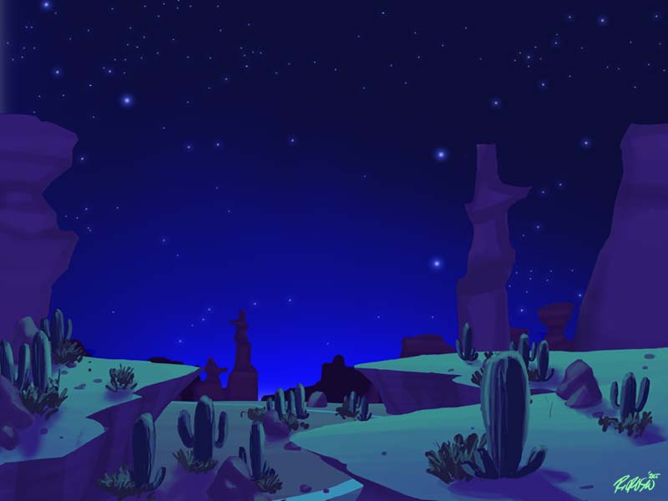
Rainstick
This Photo by Unknown Author is licensed under CC BY-NC-ND

Slide 2
For 4th and 5th grade continue working on those recorder songs if you haven’t passed all of the levels – this activity can be a fun change of pace. ☺
This Photo by Unknown Author is licensed under CC BY-NC-ND

Slide 3
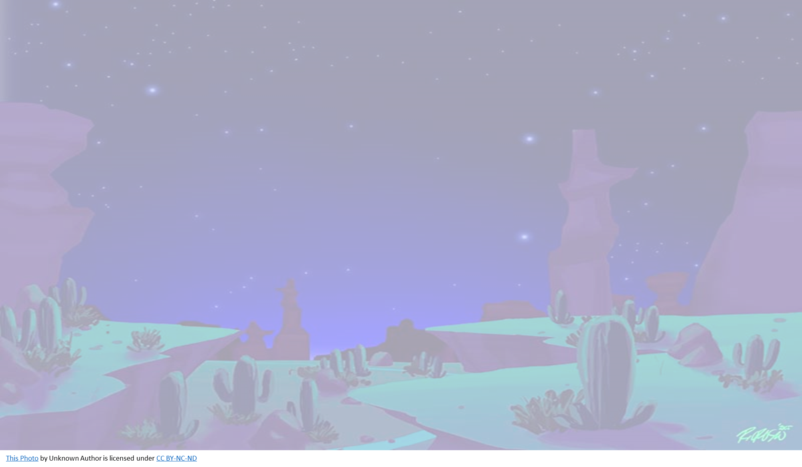
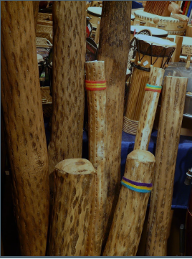
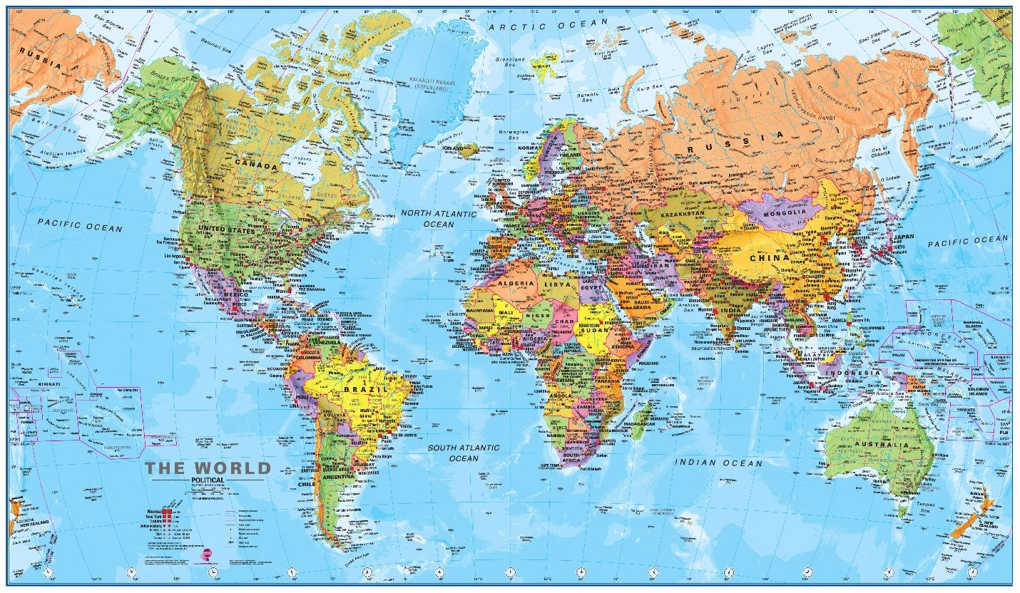
In this lesson you will learn:
What is a Rainstick?
Where do they come from?
Learn to make a Rainstick
Play along

Slide 4
What is a Rainstick?
There are many cultures around the world that often included the use of rainsticks, to help summon rain because it mimics the sound of rain.
Listen here
Rainsticks were made from items from
The environment like dead cactus
Tubes, cactus spines and tiny
Pebbles. Let’s look inside – click the video link.

Slide 5
How to make your own Rainstick?
Materials:
Paper towel or toilet paper cardboard tube
Tape or rubberbands & piece of fabric
Corn kernels, dry beans, small dry pasta or rice, small pebbles
Small piece of foil
Optional: crayons, markers, or paint to decorate your rainstick
Here is a video you can watch to learn how to make your rainstick:
https://youtu.be/FrsxnYlUMPs

Slide 6
Find a song you can playalong with your Rainstick! For an extra challenge – what other instruments could you make to go with your rainstick? Can you make a family rhythm band? What would change if you found a longer tube? I’m sure Mrs. Ledin would also love to see your creativity with your rainstick – send us a picture or video! dswartz@ecasd.us cledin@ecasd.us

